Slide 1

CUSTOMER CHURN PREDICTION
-By Lakshmipriya Thampi

Slide 2

Lot of Customers are switching to another competitive banks.
Predict which customers are going to churn
so that necessary actions can be taken by the
bank to retain such customers.
Give some recommendations on how can we prevent the customers from churning.

Slide 3

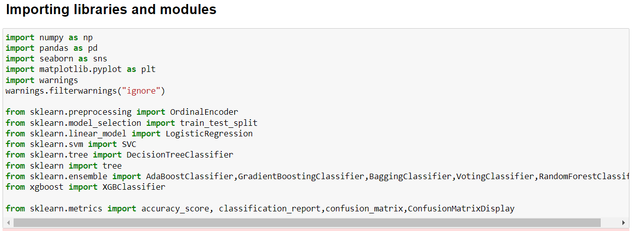

Slide 4

Loading the dataset and analyzing:
Columns in my dataset : Customer-Churn-Records.csv
RowNumber—corresponds to the record (row) number and has no effect on the output.
CustomerId—contains ids’ of the customers.
Surname—the surname of a customer.
CreditScore—can have an effect on customer churn, since a customer with a higher credit score is less likely to leave the bank.
Geography—a customer’s location can affect their decision to leave the bank.
Gender—it’s interesting to explore whether gender plays a role in a customer leaving the bank.
Age—Age of the customers.
Tenure—refers to the number of years that the customer has been a client of the bank. Normally, older clients are more loyal and less likely to leave a bank.
Balance—balance in the accounts of customers.
NumOfProducts—refers to the number of products that a customer has purchased through the bank.
HasCrCard—denotes whether or not a customer has a credit card. This column is also relevant, since people with a credit card are less likely to leave the bank.
IsActiveMember—active customers or not.
EstimatedSalary—Salary of the customers.
Exited—whether or not the customer left the bank.

Slide 5

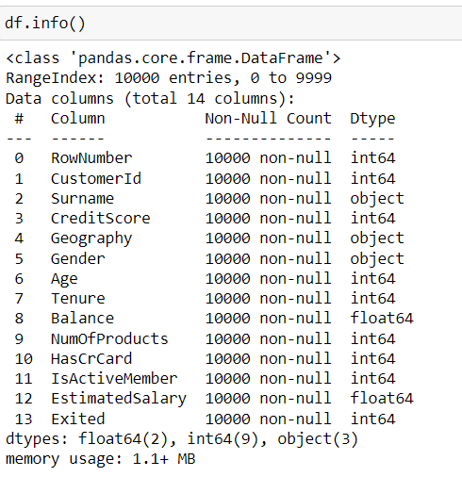
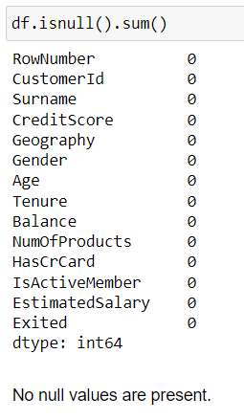
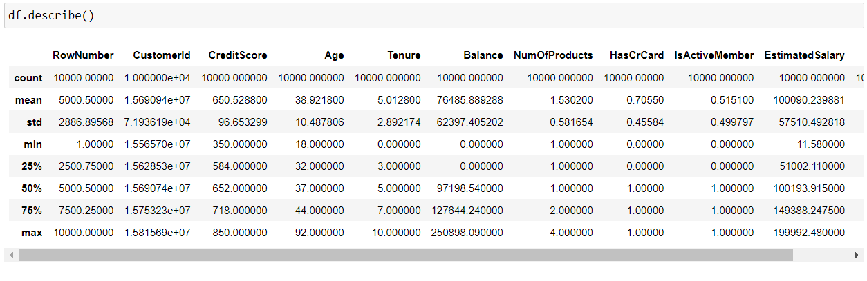

Data Cleaning and Handling
df.info() – To check for null and datatype of columns
df.describe() – For statistical summary
df.drop() – To drop unnecessary columns

Slide 6
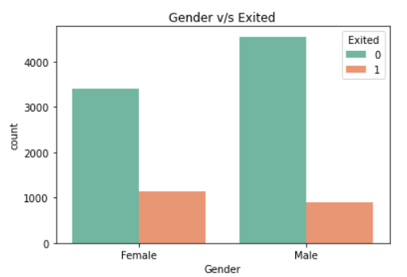
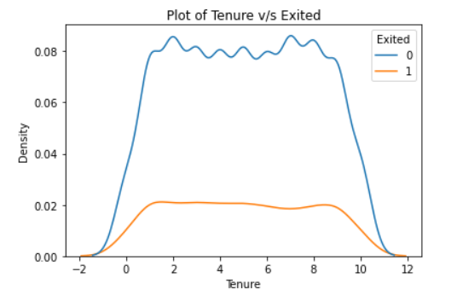
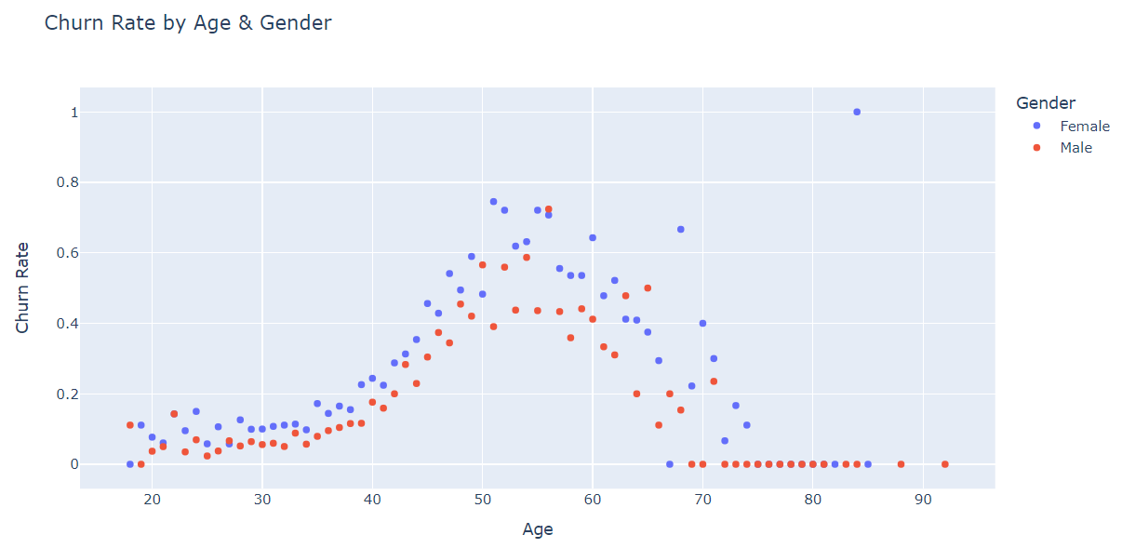
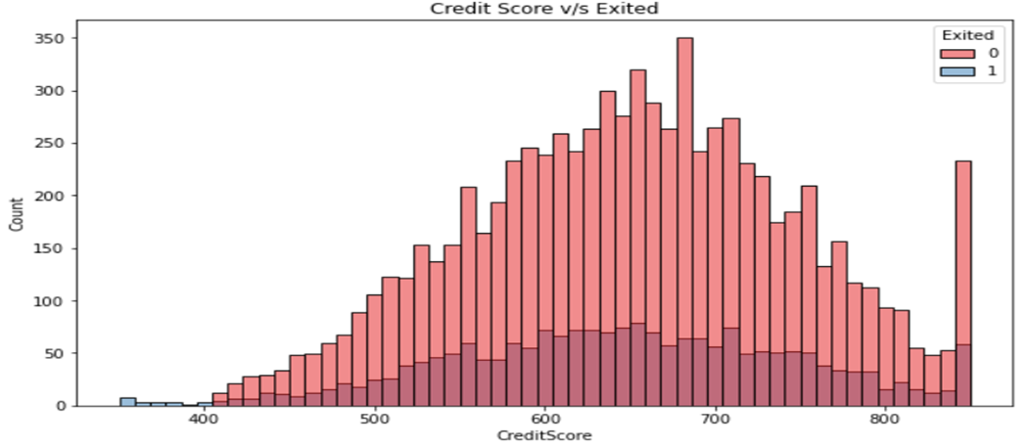
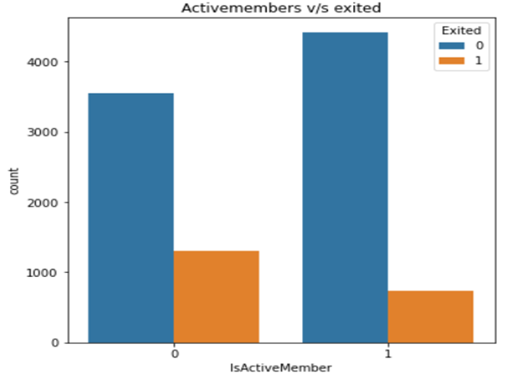
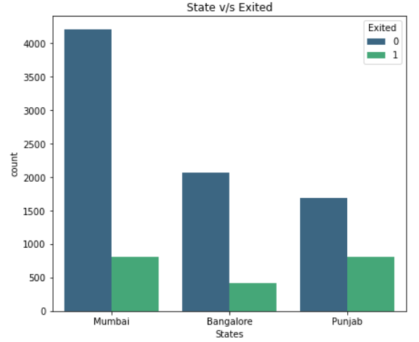

Data Visualisation

Slide 7

Final Analysis Conclusion:
Conclusion:
The lesser the tenure, more are the chances to churn.
The highest churning rate is from Punjab.
Female customers are more likely to churn.
The member who are active are less likely to churn.
The active members have bought more products from bank and hence there is very more chances of active members to churn.
The more the credit score, the less the person is likely to churn.
Customers of age between 45 - 70 have higher tendency to leave the bank.
Recommendations:
- Increase the tenure of a particular scheme rather than introducing with more products.
- You need to target the customers from Punjab and find out what is the problem for them to quit the bank services.
- Target female customers and try to bring schemes that would attract females or are in their favor.
Try to keep the members active by introducing interesting offers, insurances so as being active make them less likely
to churn.
- Try to maintain the credit score of the customers so that they would less likely leave the bank.
- Make new beneficial plans schemes for people of age 45-70 so taht they would feel secured and stick to the bank.

Slide 8
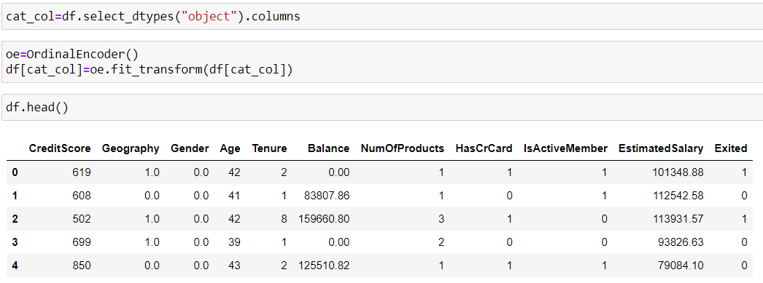
Encoding
0
1
2
Punjab
Mumbai
Bangalore
Converted Categorical columns to numerical columns.
Using OrdinalEncoder()

Slide 9
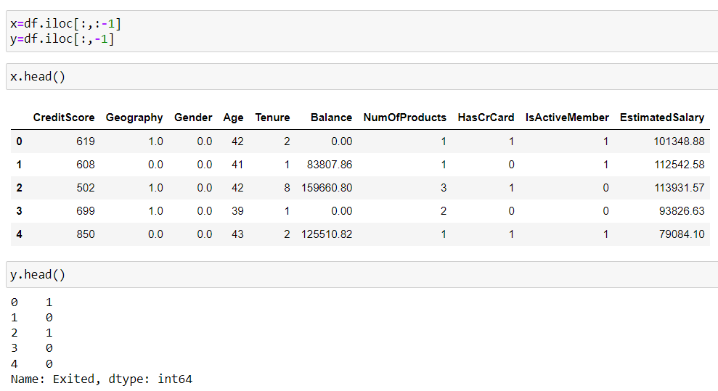
Splitting data into X (features) and Y(target)

Slide 10
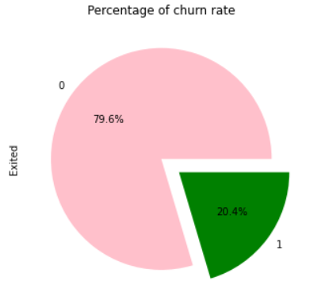
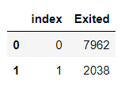
Churn rate
- The churn rate is 20%.
- The dataset is imbalanced.

Slide 11
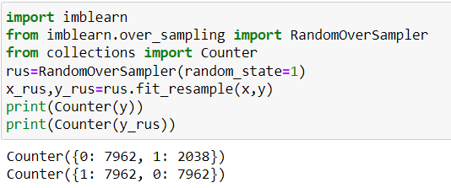
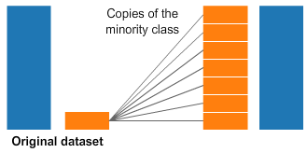
OverSampling

Slide 12
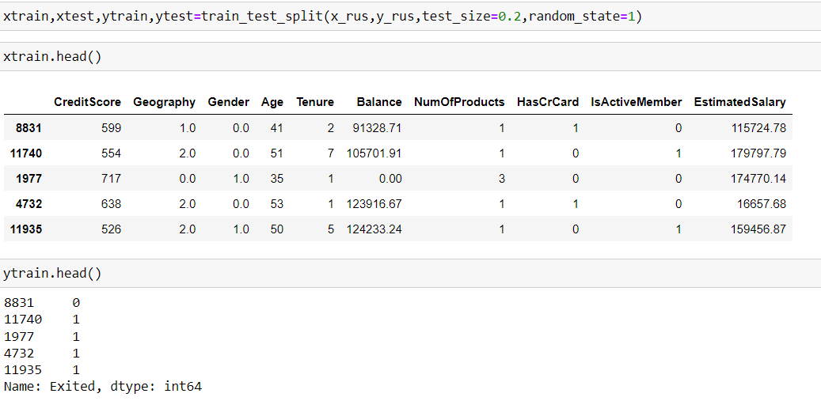
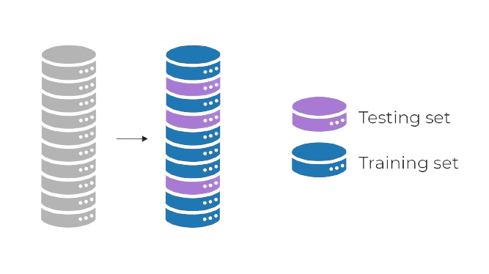
Splitting x and y into training and testing data

Slide 13
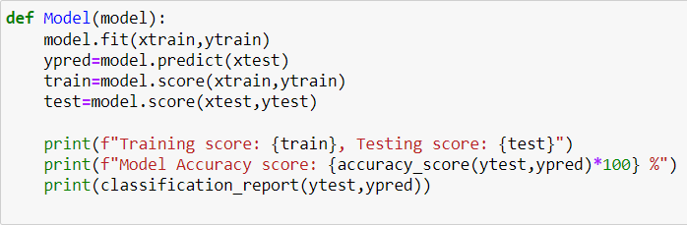
Model Building
Classification Algorithms:
LogisticRegression()
RandomForestClassifier()
DecisionTreeClassifier()
SVC()
Hypertuning :
LogisticRegression – Solvers
1) liblinear
2) sag
DecisionTree - Pruning
1) max_depth
2) min_samples_split
3) min_samples_leaf
Ensemble Learning Techniques :
Bagging :-
1) BaggingClassifier()
2) VotingClassifier()
Boosting:-
1) AdaBoostClassifier()
2)GradientBoostingClassifier()
3) XGBClassifier()

Slide 14
Model comparison

Slide 15
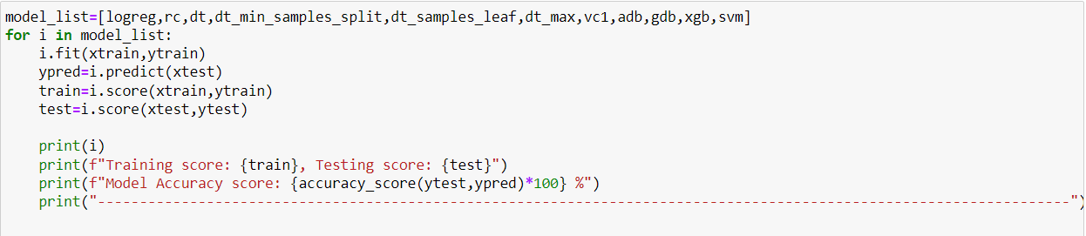
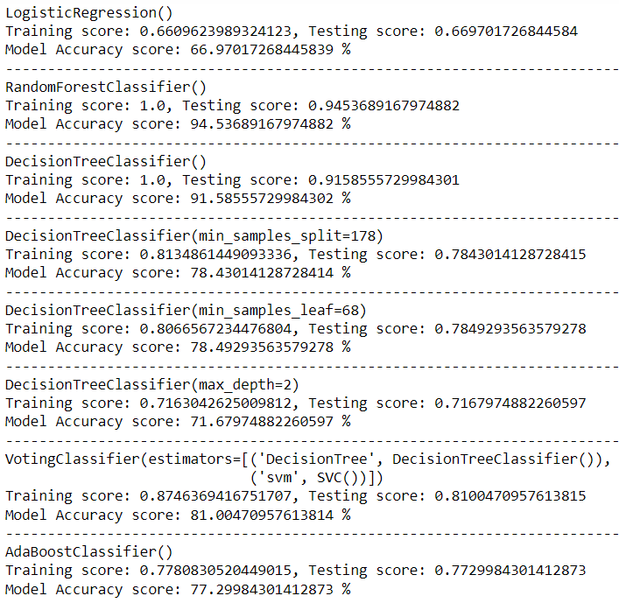
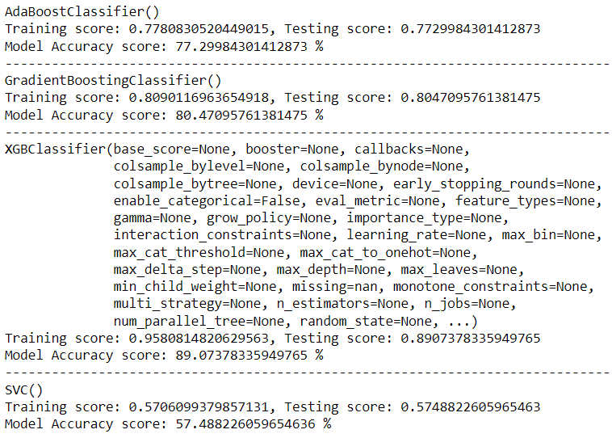

Slide 16
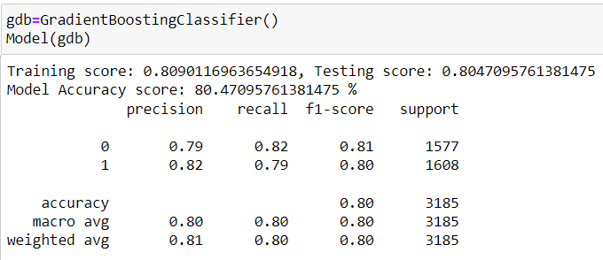
Final Model Chosen – Gradient Boosting Model
Model Accuracy: 80.47%
Training score : 80.90%
Testing score: 80.47%

Slide 17
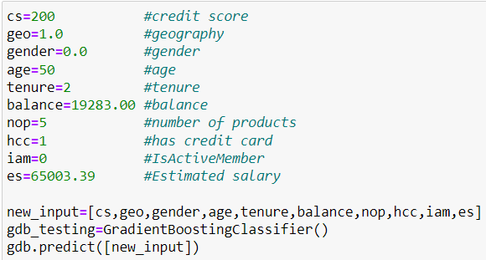
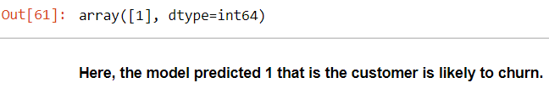
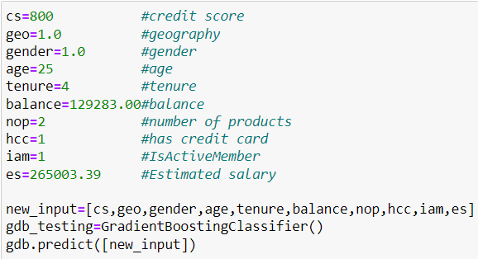
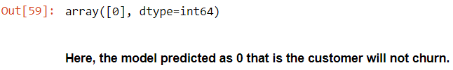
Testing with new data
Output:
Output:

Slide 18
That’s all !
Thankyou

